Slide 1
Module 1.3:
Neural Networks and Deep Models
Multi-layer Perceptron; ConvNets
ML for Cybersecurity

Slide 2
Notes:
Matt/Laura:
Suggest beginning with some sort of link to the previous segment—this doesn’t need to be part of the slide deck necessarily. But suggest beginning by comparing or contrasting this new segment on neural nets to the previous
Also suggest, as before, beginning with some motivating example, or some description of where/when/how students may want to use neural nets before diving into what they are and how they work in detail

Slide 3
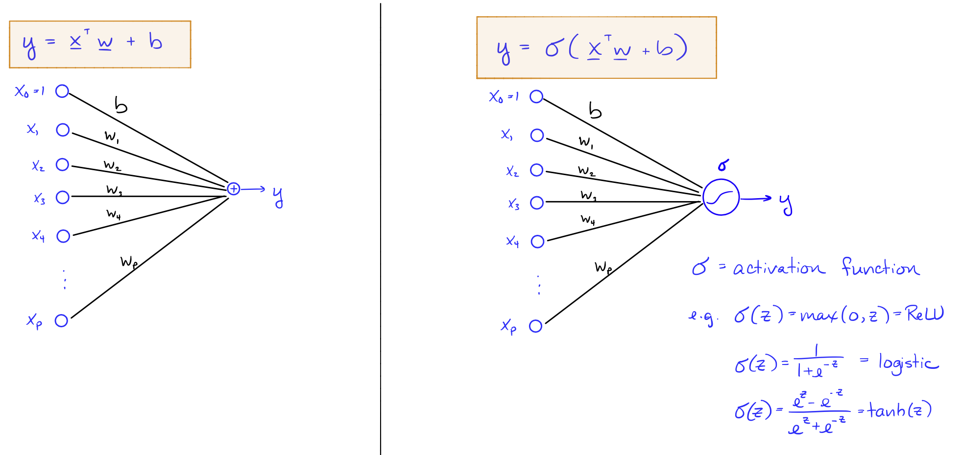
A Simple Neural Network

Slide 4
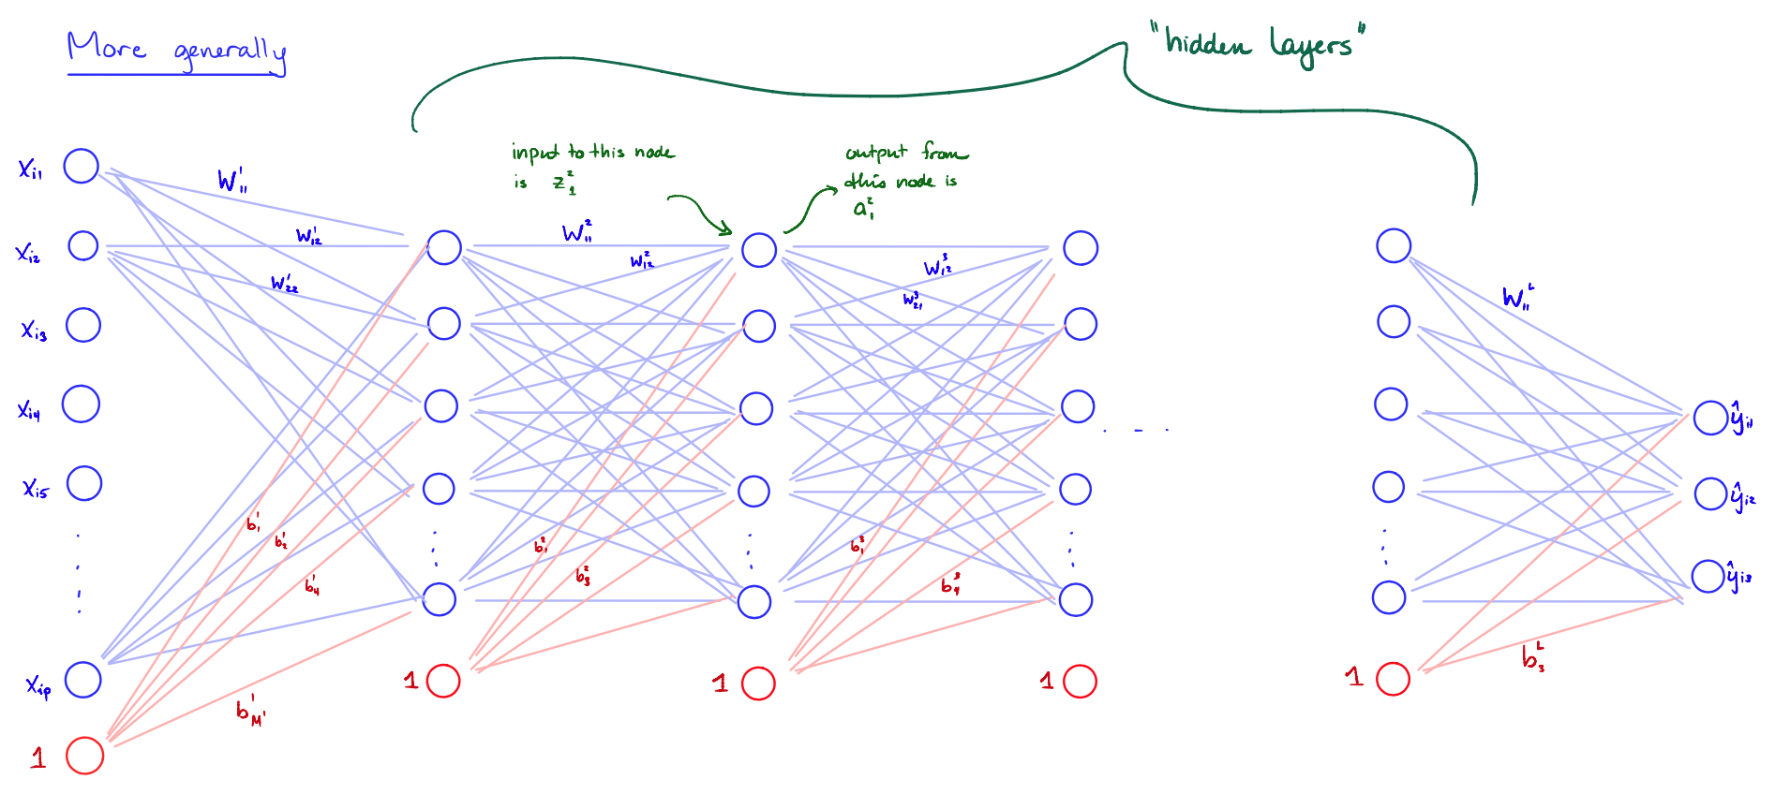
Multi-layered Networks (e.g., Perceptrons)

Slide 5
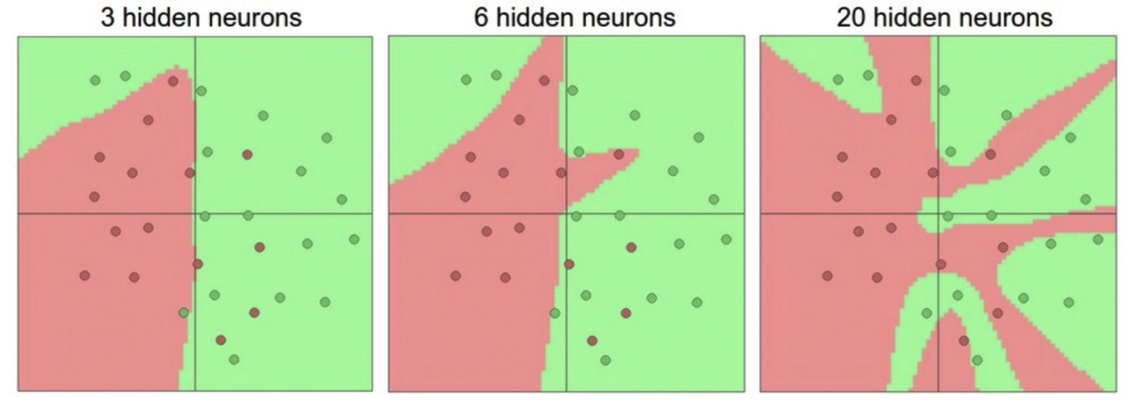
Representation Power
Neural network with one hidden layer is a universal approximator (can represent any function)
The capacity increases with more hidden layer and hidden units

Slide 6
Training Multi-layered Networks: Optimization
Neural nets can be trained via stochastic gradient descent
For deeper neural network, one can updates the weights via backpropagation
Initialization of neural nets
Initializing weights
usually initial weights are chosen to be random values near zero
Scaling input:
Standardize all inputs to have zero mean and standard deviation = 1 (making it easier to choose a good range of initial weights and easier to regularize)

Slide 7
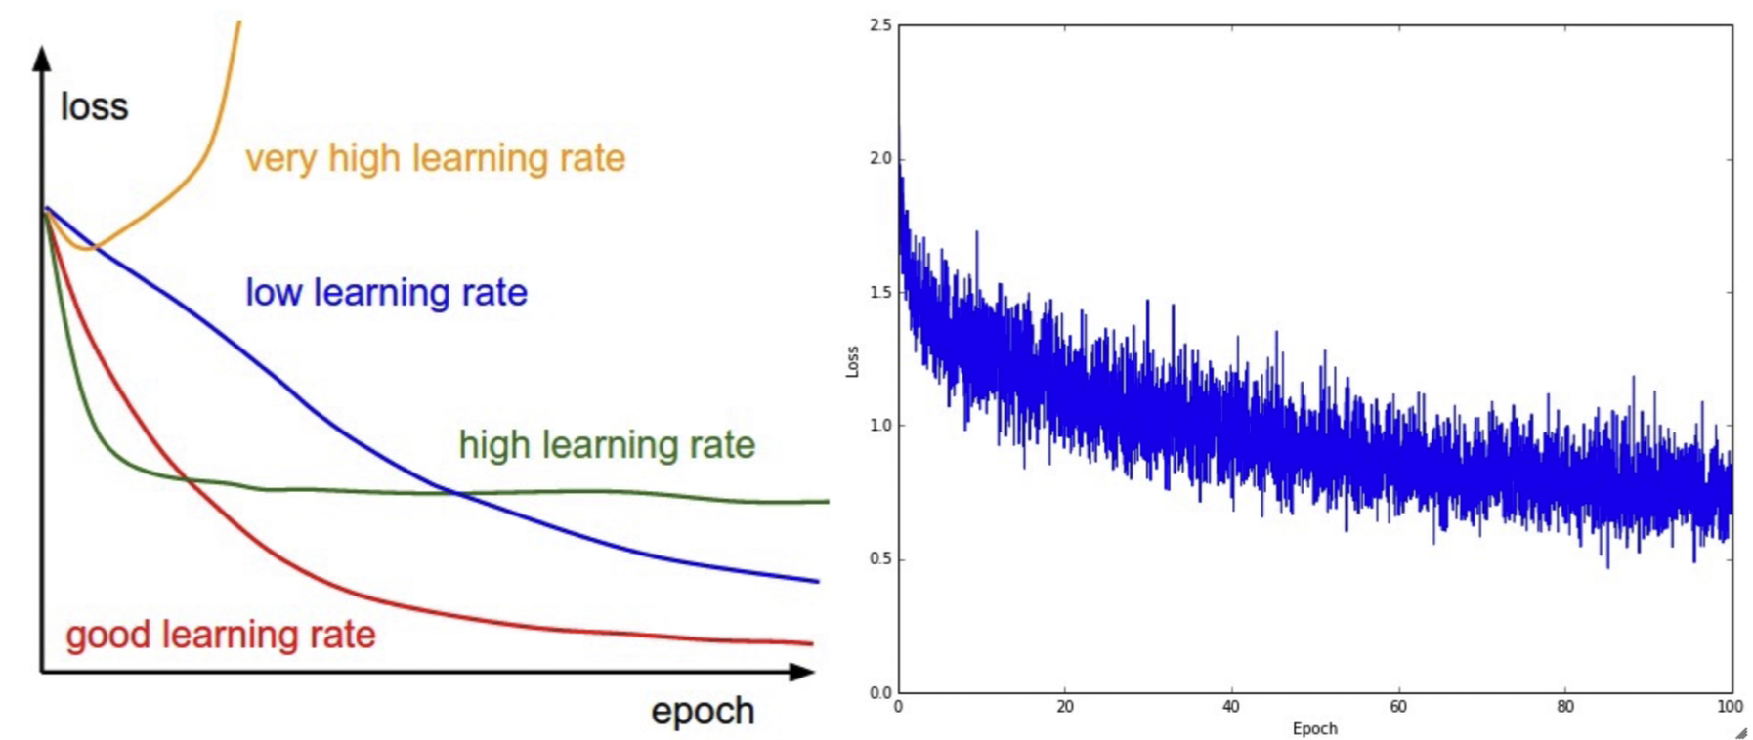
Training Multi-layered Networks: Learning Rate
How often to updates weights
Update weights after utilizing every mini-batch of training examples (i.e., an epoch)
How much to update
Learning rate effect

Slide 8
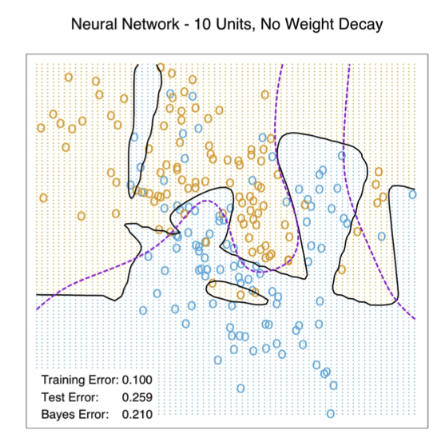
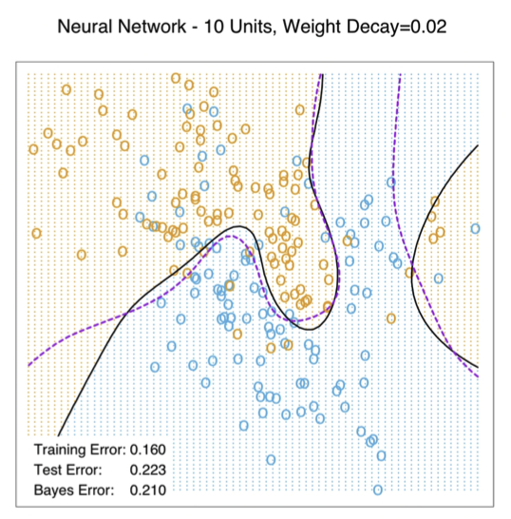
Training Multi-layered Networks: Overfitting
Early stopping
Train the model for a while but stop before convergence
Weight decay
Adding regularization to loss function
Encouraging models with “small” weights

Slide 9
Deep Models

Slide 10
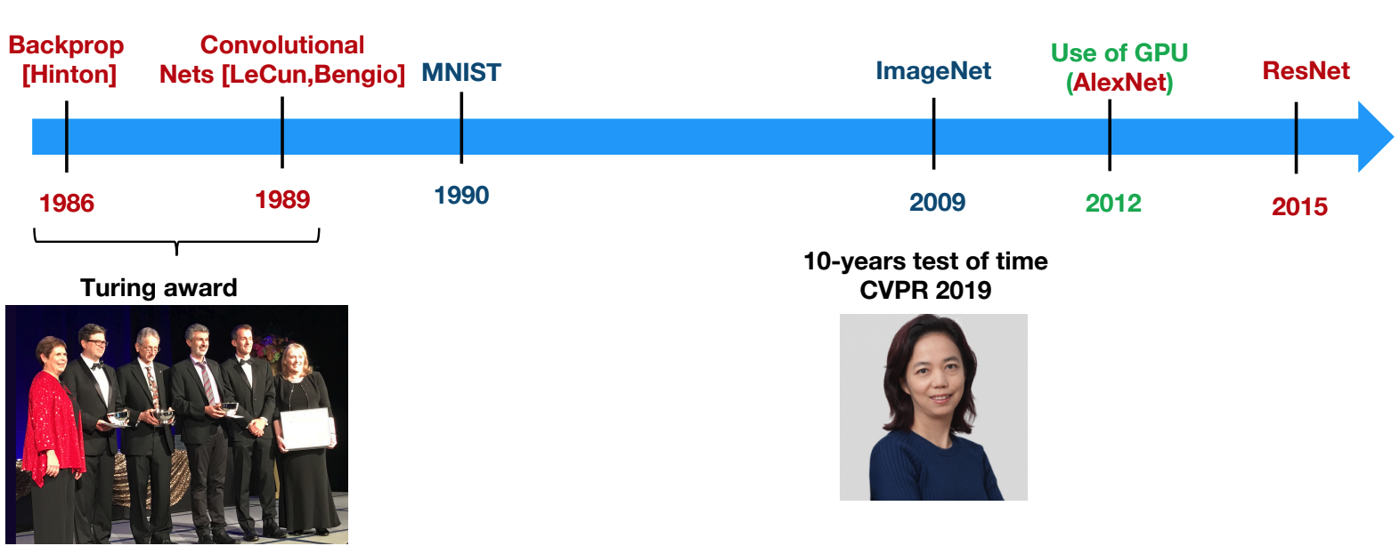
Pillars of Deep Learning

Slide 11
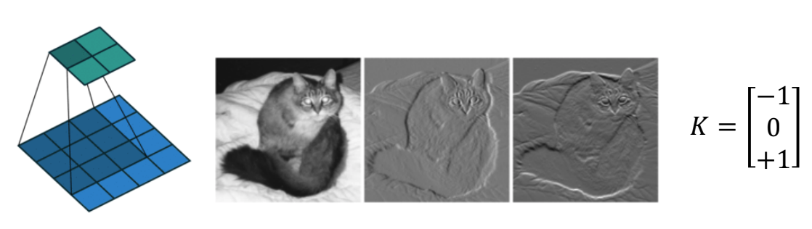
Convolutions
Convolve image with a filter
Typically, features were hand-crafter (HOG, SIFT, LBP, ...)
DCNN allows learning the features

Slide 12
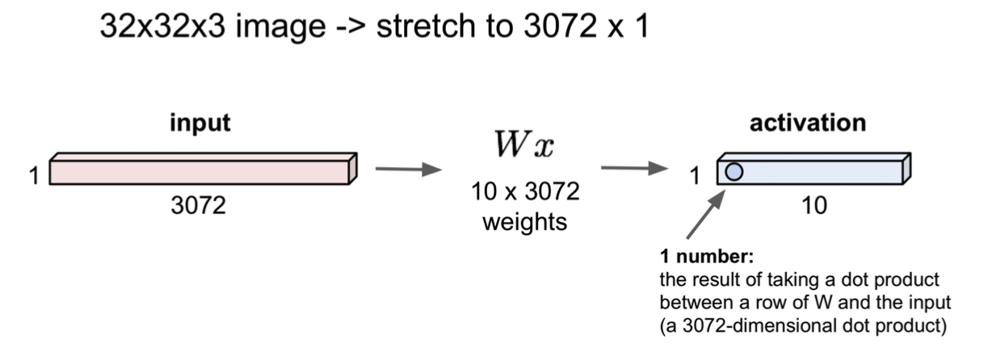
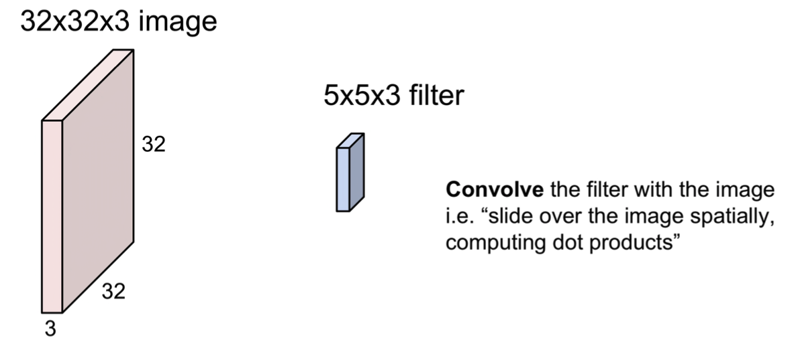
Convolutional Neural Nets
Fully connected layers
Convolutional layers
Credit: http://cs231n.stanford.edu/slides/2018/cs231n_2018_lecture05.pdf

Slide 13
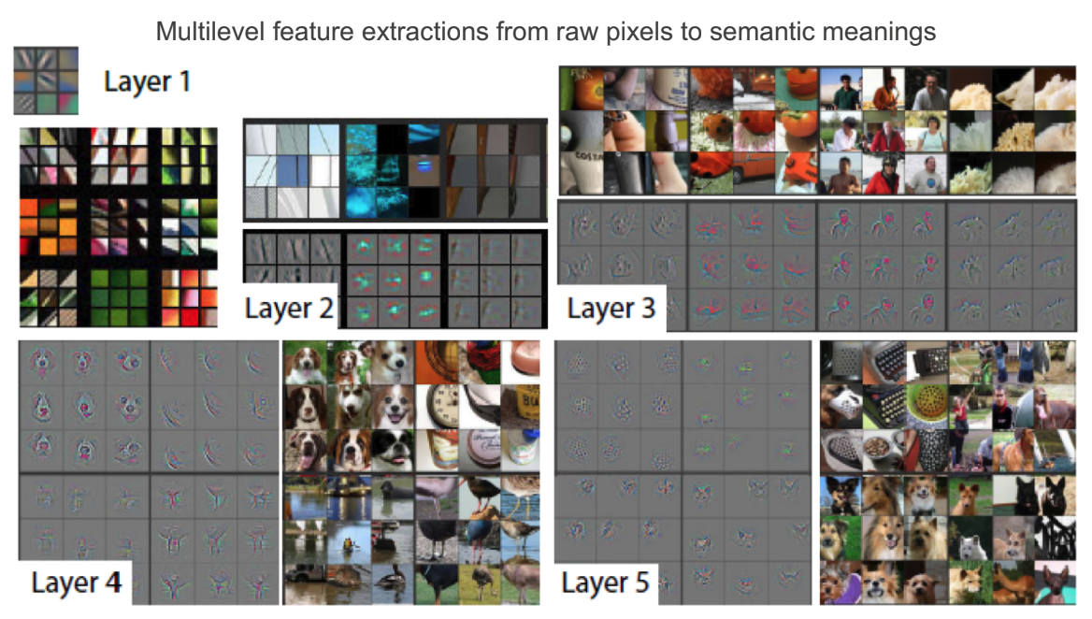
Convolution Layers

Slide 14
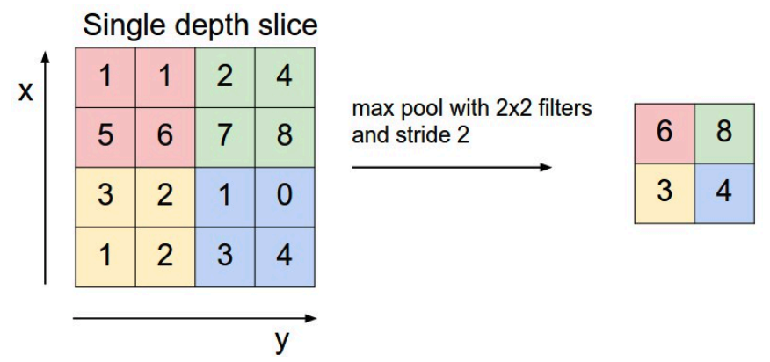
Pooling: Reduce Dimension
Subsampling: average over patches
Max-Pooling: maximum over patch — better in practice

Slide 15
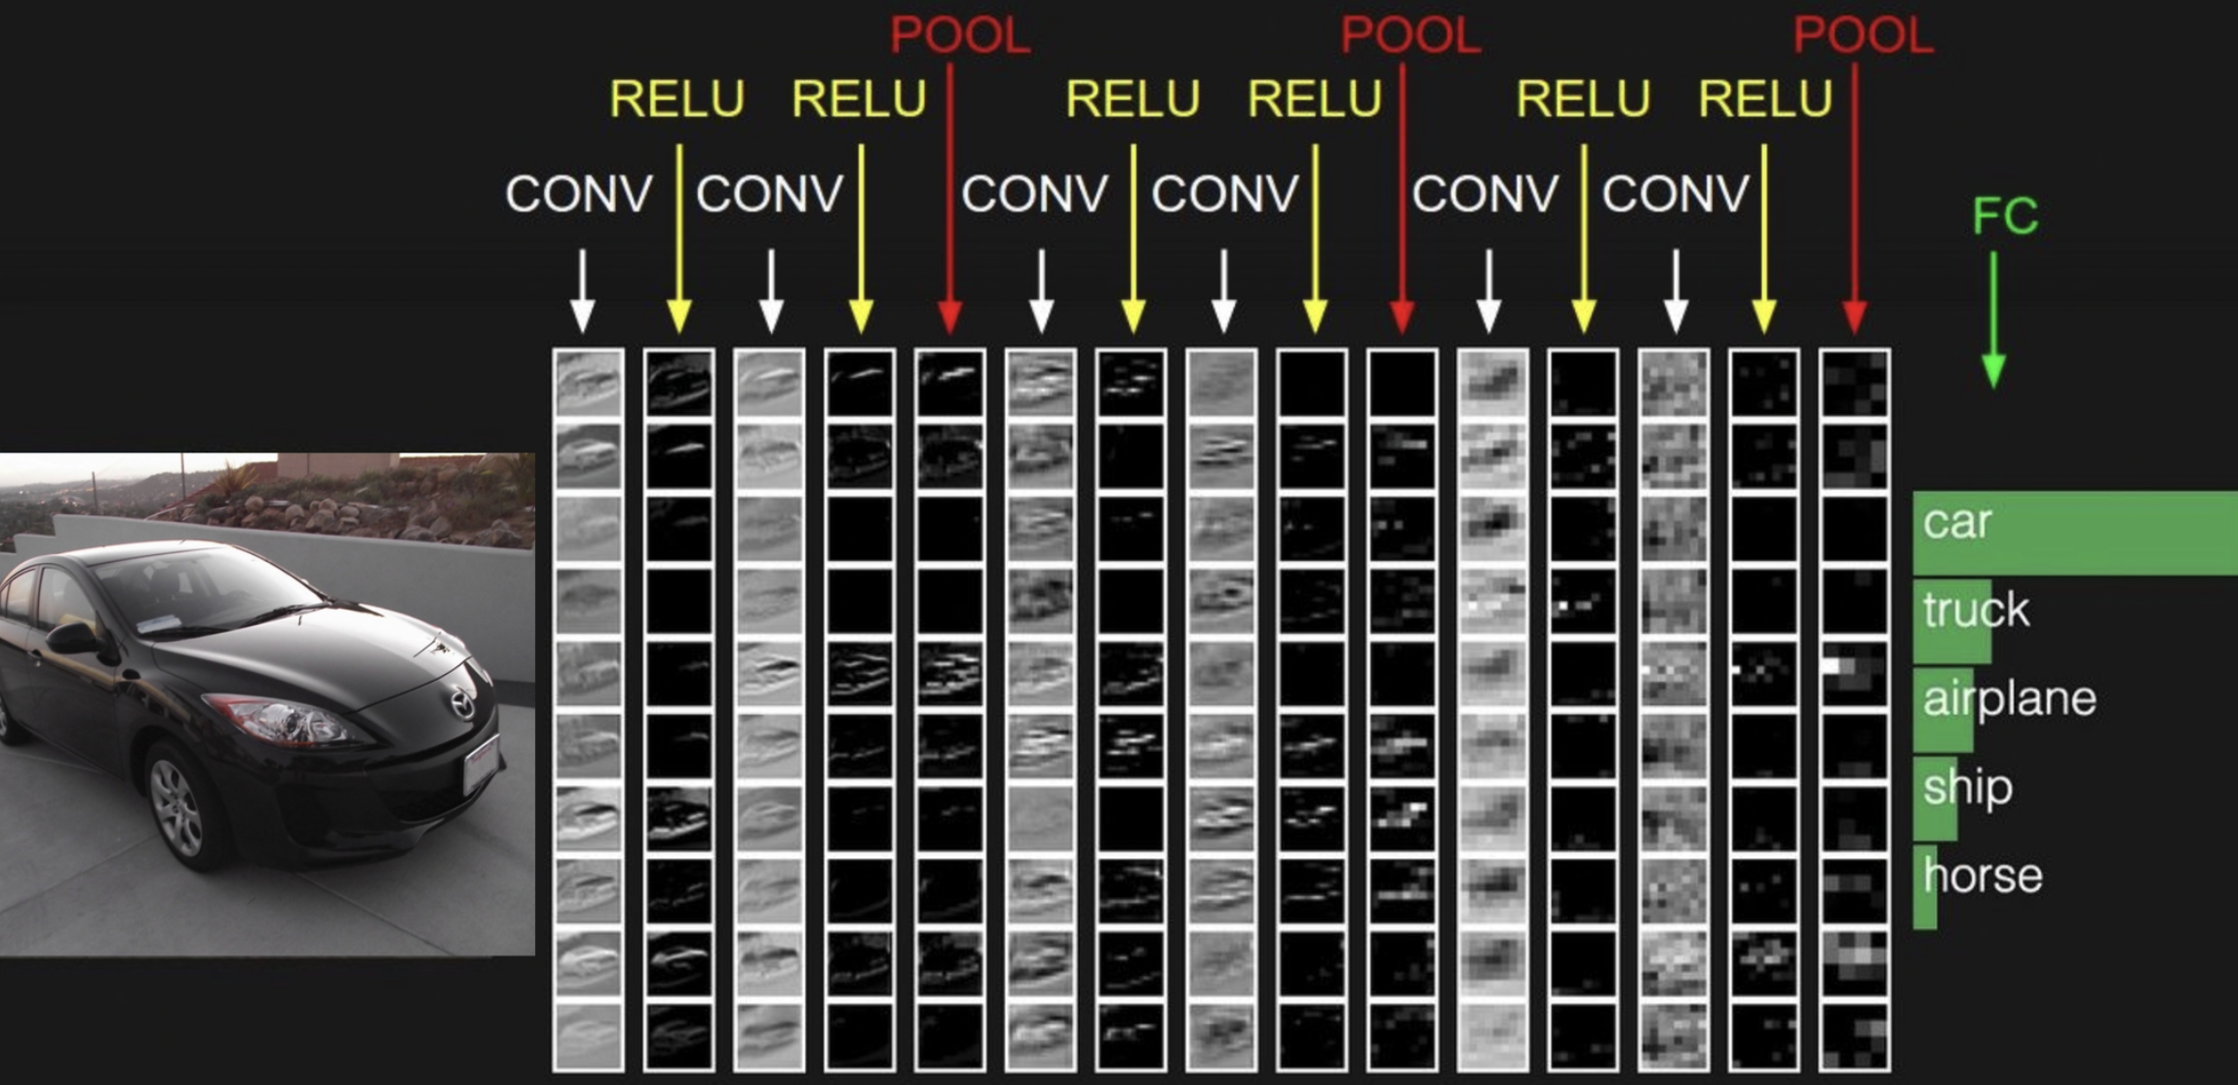
Example
Notes:
Additional slide:
Link to Nick’s work on DoS attack, forward pointing to Module 2
https://ieeexplore.ieee.org/stamp/stamp.jsp?arnumber=8424629&casa_token=zETWbScWe2YAAAAA:KunCSaVv6SZfPYlastOMZDH1qZR7vXj_xbu4XHnmijAD8TAz-1bySIRLg-I1BiMGWTWqqByoUQ
Applicability of DNN in security domain (network traffic); not necessarily more complexity
Checklist: when to use certain models → roadmap.
Model selection;

Slide 16
Concluding remarks
Notes:
Matt/Laura:
similar suggestion to last time…if possible maybe describe or summarize where practitioners might find themselves using classical methods vs different kinds of neural nets

